Slide 1
Correlation vs Causation
Notes:
Welcome to the session on “Questioning Data”!

Slide 2
Correlation and Causation: Intro
Before you start looking for connections between things in your data (like finding relationships or patterns), it's important to really understand the data itself.
Exploring Relationships:
Once you've made sure your data is good and fits what you want to study, you can start looking for connections or patterns in the data.
This is like going on a treasure hunt in your data to discover interesting relationships between different things you're studying.
Notes:
This slide highlights the importance of thoroughly understanding your data, its strengths, and weaknesses before embarking on the journey to explore relationships and patterns.
Speaker Notes:
Why Data Understanding Matters:
Before diving into data analysis, it's crucial to have a deep understanding of your data. This involves recognizing both its strong points, where it excels in showcasing information, and its weak points, where it may lack reliability.
Exploring Relationships:
Once you've ensured that your data is of good quality and aligns with your research objectives, you can begin the exciting process of exploring relationships and patterns within the data.
Treasure Hunt in Data:
Think of data analysis as embarking on a treasure hunt within your dataset. Your goal is to uncover interesting relationships, correlations, or patterns among the various elements you're studying.
:Benefits of Data Understanding:
Understanding your data is the foundation for meaningful analysis. It ensures that you can make informed decisions about the data's suitability for your research and empowers you to explore relationships confidently.
Additional Note: Just like a treasure hunter needs to understand the terrain and the clues before finding treasure, data analysts need to understand their data's characteristics and limitations before uncovering valuable insights and connections.

Slide 3
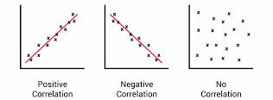
Correlation and Causation: Correlation
Correlation refers to the statistical relationship between two variables.
it can be positive, negative, or lack correlation.
Correlation is about association, not necessarily causation.
Just because two variables are correlated does not definitively mean changes in one cause changes in the other.
Notes:
This slide provides essential insights into the concept of correlation, emphasizing its role in data analysis and the distinction between correlation and causation.
Speaker Notes:
What Is Correlation?
Correlation refers to the statistical relationship between two variables within a dataset. It quantifies the degree to which changes in one variable are associated with changes in another variable.
Types of Correlation:
Correlation can be positive, negative, or lack correlation entirely. A positive correlation indicates that as one variable increases, the other tends to increase as well. In contrast, a negative correlation suggests that as one variable increases, the other tends to decrease.
Correlation vs. Causation:
It's essential to understand that correlation is about association, not necessarily causation. Just because two variables are correlated does not definitively imply that changes in one variable cause changes in the other. Correlation identifies patterns but doesn't explain the underlying causes.
Importance of Recognizing Correlation:
Recognizing correlation in data analysis is critical for identifying relationships between variables and making informed decisions. However, it's equally important to exercise caution and avoid jumping to conclusions about causation solely based on correlation.
Additional Note: Understanding the distinction between correlation and causation is fundamental in data analysis. It allows analysts to draw accurate conclusions from data and avoid making unwarranted assumptions about cause-and-effect relationships.

Slide 4

Correlation and Causation: Correlation
Attributes to evaluate include:
Adequate Data Sampling
Correlations can emerge or disappear as more data added.
Confounding Variables
Could a third confounding variable be driving observed correlation between the two variables?
Data Transformation Effects
Does scale, normalization or categorization of data skew identification of correlation strength inaccurately?
Notes:
This slide focuses on the attributes that should be evaluated when assessing correlations in data analysis, highlighting key considerations for accurate interpretation.
Speaker Notes:
Attributes to Evaluate:
1. Adequate Data Sampling:
Ensure that there is enough timely and relevant data sampled to reliably identify correlations between variables. A sufficient sample size is essential for drawing meaningful conclusions about correlations.
2. Data Volume Impact:
Understand that correlations can emerge or disappear as more data is added to the analysis. Be prepared to reassess correlations when dealing with evolving datasets.
3. Confounding Variables:
Consider the possibility of a third confounding variable that may be driving the observed correlation between the two variables under investigation. Evaluate whether there are hidden factors influencing the relationship.
4. Data Transformation Effects:
Examine how the scale, normalization, or categorization of data may skew the identification of correlation strength inaccurately. Ensure that the data transformation methods used align with the analysis goals.
Importance of Evaluation:
The thorough evaluation of correlations in data analysis is crucial for ensuring the accuracy and reliability of insights derived from the data. Addressing these attributes helps analysts make informed decisions and avoid misinterpretations.
Additional Note: Correlations can be powerful tools for understanding relationships within data, but they should be approached with a critical eye. Evaluating these attributes allows analysts to harness the full potential of correlations while minimizing potential pitfalls.

Slide 5
Differentiate between Correlation and Causation
Remember, correlation refers to situations where two variables show a statistical relationship, with changes in one variable associated with predictable changes in the other.
However, just because variables are correlated does not definitively mean one causes the other.
For example:
Research may reveal that rates of ice cream consumption are highly correlated with frequent beach attendance.
Role of weather
Avoiding Misinterpretation
Notes:
This slide serves as a reminder of the crucial distinction between correlation and causation in data analysis.
Speaker Notes:
Correlation vs. Causation:
Correlation refers to situations where two variables exhibit a statistical relationship, with changes in one variable associated with predictable changes in the other. However, it is essential to understand that correlation alone does not establish a causal relationship between variables.
Illustrative Example: Ice Cream and Beach Attendance
Consider the example where research reveals a strong correlation between rates of ice cream consumption and frequent beach attendance. It's important to note that while these two variables may be correlated, it does not mean that eating ice cream causes people to go to the beach, nor does going to the beach cause increased ice cream consumption.
The Role of Weather:
In reality, the correlation between ice cream consumption and beach attendance likely results from hot sunny summer weather, which influences both behaviors. This example highlights the potential for a hidden common factor driving the observed correlation.
Avoiding Misinterpretation:
This slide underscores the risk of misinterpreting correlations as causal relationships and emphasizes the need for cautious analysis. Data analysts should exercise prudence and refrain from making causal claims based solely on observed correlations.
Additional Note: Understanding the distinction between correlation and causation is paramount in data analysis to draw accurate conclusions and avoid misleading interpretations of relationships within data.

Slide 6
Differentiate between Correlation and Causation
Finding Real Causes:
To be sure that one thing causes another, you need to do more than just see a connection (correlation) between them.
This involves checking the order of events, ruling out other reasons, and making sure the connection holds up in different situations.
What to Do After Finding Correlations:
Discovering connections in data is like opening a door to more insights, but you need to keep asking questions to really understand why things happen.
Notes:
This slide emphasizes the importance of distinguishing between correlation and causation and provides guidance on how to ascertain true causation in data analysis.
Speaker Notes:
Finding Real Causes:
To establish a causal relationship between two variables, it's essential to go beyond observing a connection or correlation. True causation requires investigating the order of events, eliminating alternative explanations, and ensuring that the relationship remains consistent across various scenarios.
What to Do After Finding Correlations:
Discovering correlations in data is akin to opening a door to deeper insights. However, to genuinely comprehend why things happen, it's crucial to continue asking questions and conducting further analysis.
Additional Note: This slide underscores the need for thorough investigation and critical thinking in data analysis to uncover the underlying causes behind observed correlations, ultimately leading to more accurate and informed decision-making.

Slide 7
Proving Causation
Using Correlation as a Starting Point:
We can use correlation as a starting point to investigate causation.
By doing controlled experiments where we change A and see if B changes accordingly, we can start to prove causation over time.
The Value of Correlation
Even if we haven't fully proven causation yet, finding correlations is still valuable because it gives us a clue about potential connections for further study.
Notes:
This slide highlights the practical approach of using correlation as a starting point in data analysis and explains how it can lead to investigating causation through controlled experiments.
Speaker Notes:
Using Correlation as a Starting Point:
Correlation can serve as an initial indicator that two variables may be connected. To explore causation, controlled experiments are conducted, where changes in one variable (A) are introduced to observe if they lead to corresponding changes in another variable (B). Over time, this process can provide evidence of causation.
The Value of Correlation:
Even if full causation hasn't been proven yet, discovering correlations remains valuable. Correlations offer insights and provide a starting point for further study, allowing us to delve deeper into potential connections.
Additional Note: This slide emphasizes the iterative nature of data analysis, where correlation serves as a steppingstone toward understanding causation and driving meaningful insights.

Slide 8
Proving Causation
To prove causation, we need:
Strong Effects: Changes in A should significantly impact B, not just weak correlations.
Consistency: Causation should be consistent over repeated trials, not sporadic.
Controlled Experiments: Use control groups, placebos, and control for other factors to directly test causal hypotheses.
In simpler terms, proving causation requires strong effects, consistency over time, and well-controlled experiments.
Notes:
This slide outlines the criteria needed to establish causation in data analysis and provides simplified terms to understand these criteria.
Speaker Notes:
Proving Causation:
To prove causation, three key criteria must be met:
Strong Effects:
Changes in variable A should have a significant impact on variable B. Weak correlations are not sufficient to establish causation.
Consistency:
Causation should consistently hold true over repeated trials and observations, rather than being sporadic or random.
Controlled Experiments:
To directly test causal hypotheses, controlled experiments are essential. These experiments involve the use of control groups, placebos, and accounting for other influencing factors.
In Simpler Terms:
In simpler terms, proving causation requires three elements: strong effects, consistency over time, and well-controlled experiments. These criteria ensure that the causal relationship is robust and reliable.
Additional Note: Understanding these criteria helps data analysts and researchers approach causation with rigor and clarity, ensuring that their findings are based on sound evidence.

Slide 9
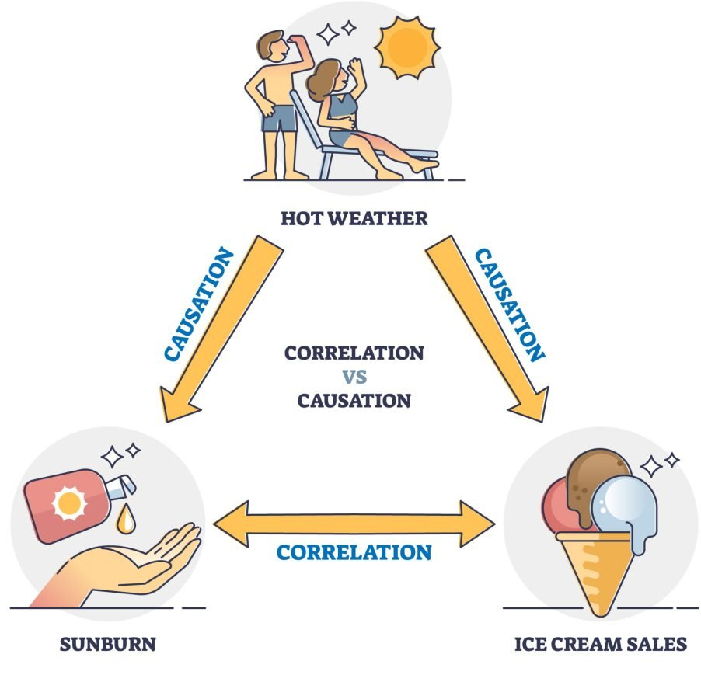
Proving Causation
When we see a correlation, we can make educated guesses about causation, but proving causation requires more than just looking at the data.
Notes:
This slide emphasizes the distinction between correlation and causation in data analysis, highlighting that while correlation can provide insights, proving causation demands a more comprehensive approach.
Speaker Notes:
The Limitation of Correlation:
Correlation can offer valuable insights and suggest potential causal relationships. Still, it does not provide conclusive evidence of causation. To establish causation, a more rigorous and systematic approach is necessary.
Additional Note: This slide underscores the importance of critical thinking and methodological rigor in data analysis, guiding analysts to exercise caution when making causal claims based solely on observed correlations.

Slide 10
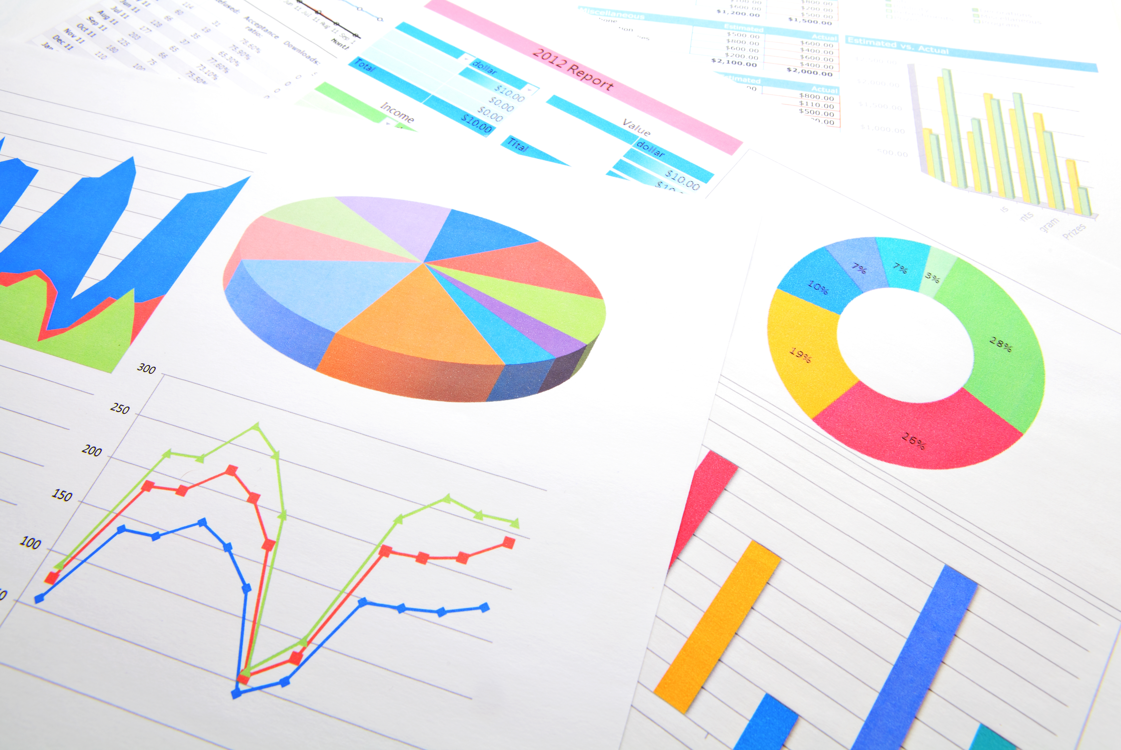
Summary
In summary, start by thoroughly assessing data quality.
Distinguish between correlations and causations, and then confirm causation through well-designed experiments, rather than making assumptions.
Notes:
This slide summarizes the key takeaways related to data quality, correlation, and causation in data analysis.
Speaker Notes:
In Summary:
Here are the essential points to remember:
- Assess Data Quality: Begin any data analysis project by thoroughly evaluating data quality, including its accuracy, relevance, and completeness.
- Distinguish Between Correlations and Causations: Recognize the distinction between correlations, which indicate statistical relationships, and causations, which require rigorous proof through experimentation.
- Confirm Causation: To establish causation, conduct well-designed experiments rather than making assumptions based solely on observed correlations.
Additional Note: This summary slide serves as a quick reference for the fundamental principles in data analysis, emphasizing the importance of critical evaluation and evidence-based conclusions.

